Slide 1
Lead Teams
If you were arrested right now for being honest;
is there enough evidence to convict you?
Session Five
Ethics and Teams
S5-Jan 2019 v.2
Notes:
Instructor Guidance:
Purpose: Provide overview of Session Five emphasizing the practice of ethics in teams.
Discussion: Check to see if there are any lingering questions or concerns from previous sessions. Ensure you address the effects of dishonesty, i.e., creates doubt in others, generates illusions of honesty in oneself and hurts people.
Question: If you were arrested for being honest, would you be convicted?
Next Slide: Learning objectives.

Slide 2
Objectives
Understand and explain Team ethics.
Understand and explain ethical
Team leadership.
Write an individual reflective summary of the course—Lead Teams. (Content and future application).
Notes:
Instructor Guidance:
Purpose: Explain the learning objectives
Discussion: N/A.
Question: Does everyone understand the objectives?
Next Slide: Video of team ethics.

Slide 3
All for One
Notes:
Instructor Guidance:
Purpose: Provide video to show the humorous side of lying and wrongful blaming of others.
Discussion: The key to emphasize is that we are, as a team, all in it together. United we stand and divided we fall.
Question: N/A.
Next Slide: Let’s Be Cheaters.

Slide 4
Let’s Be Cheaters?
There must be advantages to cheating because the
majority of workers do it:
SMORC
Billing Hours
The volunteers at the Kennedy Center
Golf and Rockefeller
Notes:
Instructor Guidance:
Purpose: Provide an explanation and develop a conversation of why we cheat.
Discussion:
In his book (Ariely, 2012), Dan discusses the proliferation of cheating and dishonesty in our society. He provides an example of an invited lecturer who claimed he would teach the students how to make lots of money—cheating (pp. 11-14).
Simple Model of Rational Crime (SMORC) is a theory of comparing the benefit gained from doing a crime to the probability of getting caught, to the expected level of punishment. A simple cost/benefit analysis without any consideration of the impact it has on other members of a family, organization, or society.
Not all actions are societal crimes punishable by law, but are still negative actions that harm oneself or others. The three examples are explained in the book and suggest that some actions lead to more egregious acts and behaviors.
The 1925 U. S. Open, Bobby Jones takes a stroke because his ball moved while he was preparing to hit it out of the rough (Ariely, p. 56). Also John Rockefeller was a stickler for counting every stroke, lie about this, you lie about other things—it is about the rules.
Study (pp. 51-64) of golfers and cheating, moving with a club, kicking and then picking it up—23%, 14%, 10%. Taking mulligans, 40% scoring write it 15% and add it 5%
Question: Engage the students as each bullet is clicked on.
Next Slide: What is Team Ethics

Slide 5
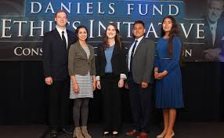
What is Team Ethics?
The overall purpose of developing and practicing
ethical behavior in teams is to create a work climate
that fosters:
Trust
Commitment
Cooperation
Notes:
Instructor Guidance:
Purpose: Provide an explanation and develop a conversation of what team ethics means to us in the workforce.
Discussion:
Ethical behavior means everything is performed honestly and for the well-being of the team in order to achieve common goals and objectives (By Gurpreet kaur article in references).
If all teammates are behaving ethically, the likelihood of trusting each other is increased. Teammates rely on each other for their jobs, reputations, and mission accomplishment. Use the example of Helicopter technicians in the Army, you fix it, you fly in the test flight to ensure it is fixed.
It is easier to commit to the team/organization’s vision and mission if those elements are based on honesty.
Team members are more likely to cooperate and collaborate with each other if they work in a work environment where integrity is an action verb in their team.
Key to understanding and applying team ethics is the effects of ethical behavior on the overall ethical climate within your work environment.
Question: Engage the students as each bullet is clicked on.
Next Slide: Ethics in the workplace.

Slide 6
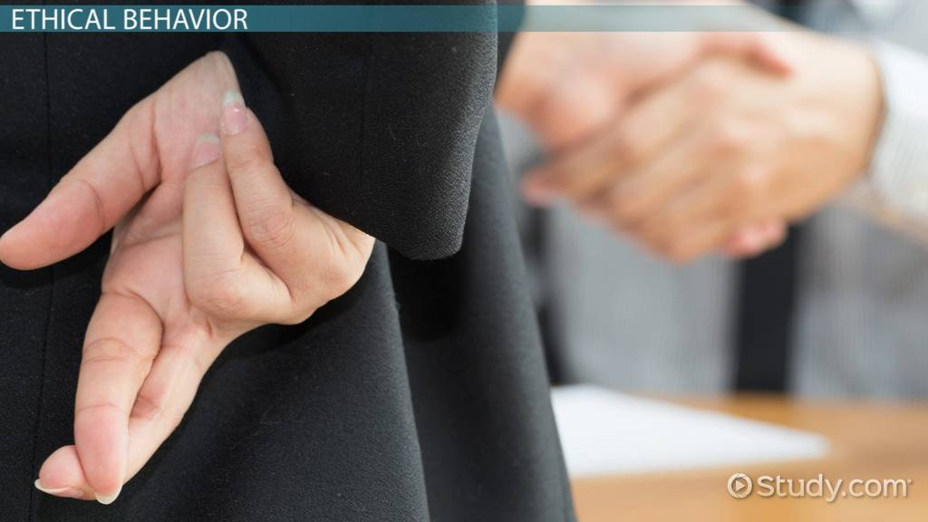
Ethics in the Workplace
What does “Right” ethical decisions look like?
How does the team evaluate its ethical climate? (KER)
Is situational ethics used where you work?
(judging others by their actions and judging ourselves by our intent)
Notes:
Instructor Guidance:
Purpose Slide: Continue discussion of ethics in the workplace.
Discussion: 1. What does “Right” ethical decisions look like? (A popular saying emphasizing that some actions have to be done regardless if anyone knows you are doing right). 2. What might appear ethical to the leader may not be the same interpretation members of the team have of it. What should an ethical decision include? For one, it should be a decision that is fair, impartial, and benefit the team. 3. The team leader reviews behaviors and policies' used within the team and then makes adjustments where and when required. Key is to ensure everyone understands why changes are needed. Suggest getting team feedback to better judge the climate and their reaction to a change in policy. 4. The leader’s use of KER is important to avoid overreaction or inappropriate decisions. Decision should match the situation.
Question: Have students respond to the bullets.
Next Slide: Team activity.

Slide 7
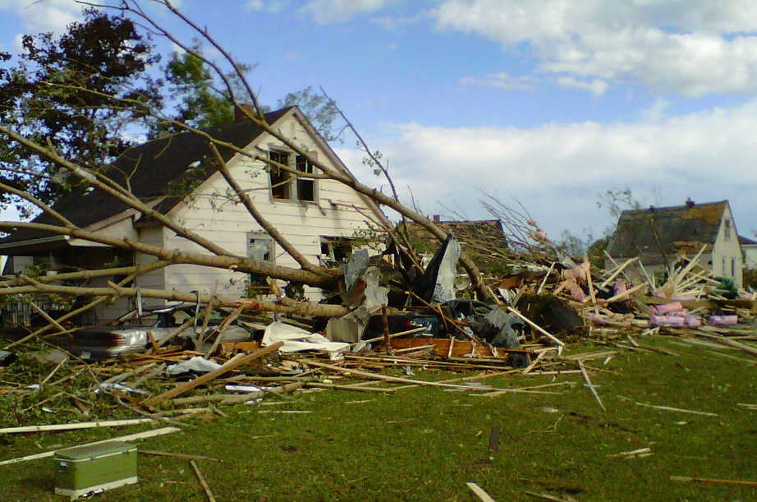
Team ethics in dealing with an emergency--Activity
Hurricane Michael 18 Oct 2018 MCLB Albany
Your team is responsible for scheduling and tracking critical base housing
emergency maintenance service for your installation.
A hurricane hit the installation last night causing serious damage—especially
base housing!
The current weather is 45 degrees and windy!
Your team is inundated with calls for maintenance help.
How will your team handle this situation?
Who gets help/repair priority?
How to deal with overly agitated requesters who demand priority?
Notes:
Instructor Guidance:
Purpose Slide: Team activity that looks to unravel ethical behavior that a team experiences in a critical situation.
Discussion: 1. Installations have published guidance on how emergency maintenance services are to be applied in critical situations. The big question is—are they? After Hurricane Isabel hit Camp Lejeune in 2003 and a tornado that hit MCLB Albany in 2017, complaints from base emergency services personnel and base residents show that polices were not necessarily implemented fairly or equitably. This scenario is based on those two and the most recent Oct 2018 Hurricane Michael at Albny. 2. The point of the activity is to examine how a team handles the situation. Ethics comes into play when priority of base housing work is matched up with individual family requests. Do friends get better services? Do senior ranking people get priority? 3. Does the team decisions match the situation?
Question: N/A.
Next Slide: Take break.

Slide 8
10 Minute Break!
Notes:
Instructor Guidance:
Purpose Slide: Announce Break.
Discussion: Keep track of time because the last part of this session is to have the group work on their end of course presentation. It is about content more than about form.
Question: Check to see if there are any lingering questions and stick around in case anyone wants to talk.
Next Slide: Integrity.

Slide 9
Integrity—a key to Leader ethics
An individual quality which is “The state of being complete, unified [in action and deed].” You have integrity when your words and deeds match up, no matter where you are or who you are with.
Integrity does what for teams?
How to build it?
Role Models
Notes:
Instructor Guidance:
Purpose: Provide an appreciation and understanding of how integrity influences leading others.
Discussion: 1. Our actions and decisions reflect our inner thoughts and desires. If they are not aligned with what we preach concerning honesty, others will turn from us because they cannot trust us. Focusing us on integrity provides us with insights into:
Trusting others
Building credible reputations
Standards to live by
2. Practice honest and sincere intentions coupled with matching actions.
Questions: Have students respond to the question posited by the main bullet.
Next Slide: Ethical Team Leadership.

Slide 10
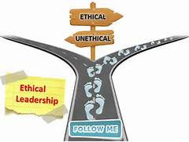
Ethical Team Leadership
Successful and effective team leaders put their
integrity and moral behavior into action and adhere to
them always by “doing the right thing, at the right
time, for the
right reasons.”
As a leader, is showing ethical values important?
How do you encourage others to be ethical?
Notes:
Instructor Guidance:
Purpose: Explain and discuss why leaders use ethics.
Discussion: 1. As discussed in the article “Ethical Leadership: Doing the Right Thing”, a leader should exercise sound ethical behavior regardless if anyone is watching or not. This behavior is based on some type of rules or codes. At times we find it difficult to reward or recognize positive ethical behavior because the rules or codes may be unpopular in contrary to popular opinion. 2. Yes because through our examples we show the right way of doing team business. 3. How do you find good role models? By studying people who show integrity in all situations, i.e., read about people who do it. 4. Encouraging others to be ethical means knowing your people and remaining engaged with them. By coaching, counselling and mentoring them to be ethical.
Question: As each bullet appears, engage students for their perspective.
Next Slide: Power corrupts.

Slide 11
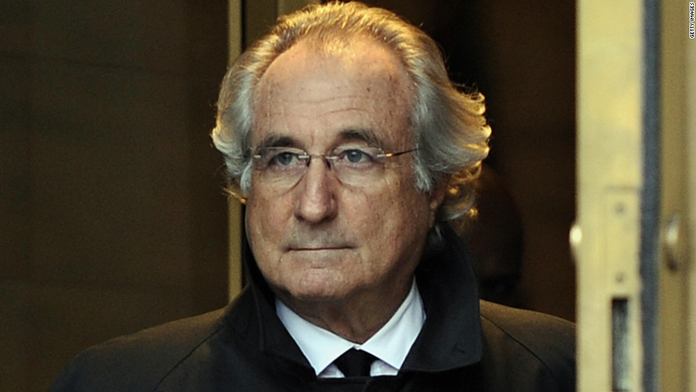
Power Corrupts
Power corrupts our ability
to lead or act ethically!
Does it?
What about control freaks? Is the “intent” of your instructions or decisions perceived as “in the interest” of the team’s effort and focus?
As the leader, I am above the team rules!
Do what I say not what I do!
Bernard Lawrence Madoff
Notes:
Instructor Guidance:
Purpose: To develop discussion around the problem of being compromised when gaining power.
Discussion: 1. Without a clear understanding of how one manages processes and leading others to positive mission end states, one can be overwhelmed with the side affects of welding power within groups and organizations. 2. History is replete with the stories of those leaders who end up ethically bankrupt from the effects of power. LtGen R. Moore (CG, MARFORPAC—April, 1992) (Cheated on flight test and sleeping with his driver). Madoff and the Ponzi fund scandal Mar 2009. 150 years prison. 3. How does one avoid getting power corrupt?
Questions: Ask students to respond to the bullets .
Next Slide: Team activity.

Slide 12
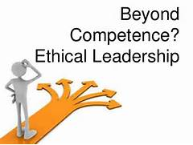
Team Activity
For a leader, ethics is about decision making—deciding
what side of social and
institution rules, norms,
and behaviors best meet
the vision and goals of the
Organization—The Team!
What is more difficult to do? Making the “Right” decision when no one agrees with it or making the wrong decision that others like best?
Share your opinions amongst team members, summarize
opinions and then share with seminar!
Notes:
Instructor Guidance:
Purpose: Examine and discuss leader decision making when dealing with ethical situations.
Discussion:
Key is to have students share their views on how do you make ethical decisions. A part of that decision making process is making decisions that are very unpopular or seemingly not in the best interests of the team. Leaders are expected to make ethical decisions based on their knowledge, experience, and research (KER) that are based on sound ethical principles, norms, and rules.
In Maxwell (1993), he states that “Don’t let yourself be victimized by the age you live in. It’s not the time that will bring us down, any more that it’s society. There’s a tendency today to absolve individuals of moral responsibility and treat as victims of social circumstances. You buy that and you pay with your soul. What limits people is lack of character.” When the character of the leader is low, so are their standards” (pp. 41-42).
Questions:
1. Is it more difficult to do the “Right” thing when no one is looking or when everyone is looking? (If doing the right thing is very unpopular or by doing the right thing you look and act like the goof, suck-up, or the phony).
2. How does the team leader evaluate the ethical climate?
Next Slide: Summary od session.

Slide 13
Summary
Examined what does Team ethics mean to us.
Explaining how a leader shows and applies ethics with a team.
Wait!
Notes:
Instructor Guidance:
Purpose: Provide a summary of what transpired in this session.
Discussion: Address the key learning that occurred when discussing the objectives.
Question: Ask if there are any lingering thoughts or questions .
Next Slide: Writing the reflective paper.

Slide 14
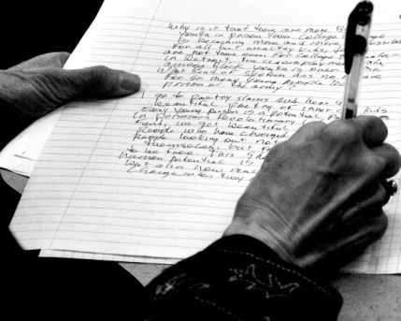
Individual Requirement
Write a reflective paper on your experience in Lead Teams. Emphasis on:
What key learning objectives did you like best
How were they reinforced in seminar sessions
How you will apply this knowledge as a leader
Your responses will be shared
with team members during
Session Six.
Give me your paper
at the end of Session Six.
Notes:
Instructor Guidance:
Purpose: Explain the individual writing assignment
Discussion:
The point of this requirement is have students individually write an informal reflection of the seminar course focusing on three areas:
What I learned
How it was reinforced in the seminar sessions
Explain how they will apply the new knowledge to be a better leader.
They will use the remainder of Session Five to achieve this requirement.
They may want to discuss their viewpoints with others which is fine but not required.
They will keep their papers to use in Session Six.
Question: Check for questions.
Next Slide: N/A (When complete, go to lunch)

